Slide 1
Mining the Relationship between Crime, Poverty, and Noise Complaints in New York City
Franco La Bruna
Yuchen Zheng

Slide 2

Background
The City of New York maintains a 311 service request hotline, where residents can call in about non-emergency events such as loose trash, missing signage, vermin infestations, excessive or disruptive noise, etc.
In particular, we’re interested in noise complaints, and whether they can say anything about crime and poverty in New York City.
Image Source: Wikipedia

Slide 3
Data Sources
Noise Complaints sourced from NYC OpenData, a website maintained by the City of New York that tabulates urban data about the city
Specifically, we pull all noise complaints from 2010 to 2015 from the ‘311 Service Requests’ database (about 2.5 million entries)
Crime data between 2010 and 2015 pulled from the NYPD website, and tabulates crime statistics per precinct in NYC
Poverty data taken from New York State Census of 2010, and consists of a single weighted percentage of population below poverty line in a given ZIP code in NYS

Slide 4
Preprocessing
Noise complaint data had a ton of info not conducive to pattern mining
Data entries organized as follows: for every noise complaint, we append the poverty and crime data for the corresponding ZIP code and precinct, respectively
Crime datasets needed reformatting to suit a Python list, including removing labels, disclaimers, and other non-info material
Poverty dataset had to be pulled from an HTML page and cleaned of non-info elements, and non-NYC ZIP codes were purged
Finally, we had to compile a list that maps precincts to ZIP codes so we could relate the poverty and crime data.
Finally, we had to bin poverty and crime data into the 6 levels of a box-and-whisker plot
Had to do a lot of work manually such as matching every zip code with the precinct since all the things we can get from the Internet are incomplete.

Slide 5
Pattern Mining Results
To find patterns in the noise complaint data, we organized them into 15-dimensional transactions with the following layout:
We then feed the transactions into a Python implementation of FP-Growth to find frequent patterns, and association rules.
Index of complaint | Created Date | Description of complaint | Location Type | ZIP Code | City | Borough | Population of ZIP code | % Below Poverty Level | Year | Violation Offenses | Misdemeanors | Major Felonies | Non-major Felonies

Slide 6
Pattern Mining Results - Citywide, Over All Years
Lower than median individual crime levels occur frequently with other lower than median crime levels, and with high (>70%) confidence
Lower than median poverty levels associated with lower than median crime levels, with high confidence (>70%)
Residential noise complaints are far and away the most common types of noise complaints (~60% over all years)
Residential noise complaints are slightly more frequently associated with higher than median poverty levels than the reverse. This suggests the poorer ZIP codes of NYC file more noise complaints, but this is not extremely clear.
All frequent data is within the IQR, which is reasonable since we do not expect outliers to be frequent.

Slide 7
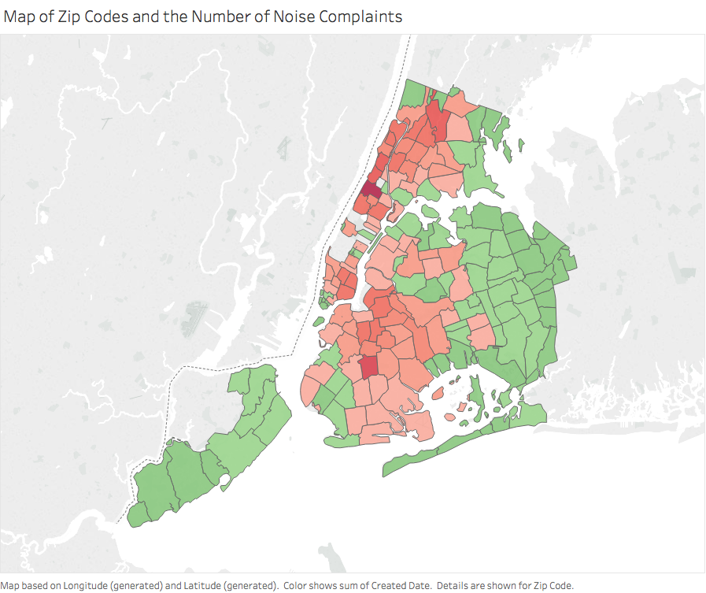
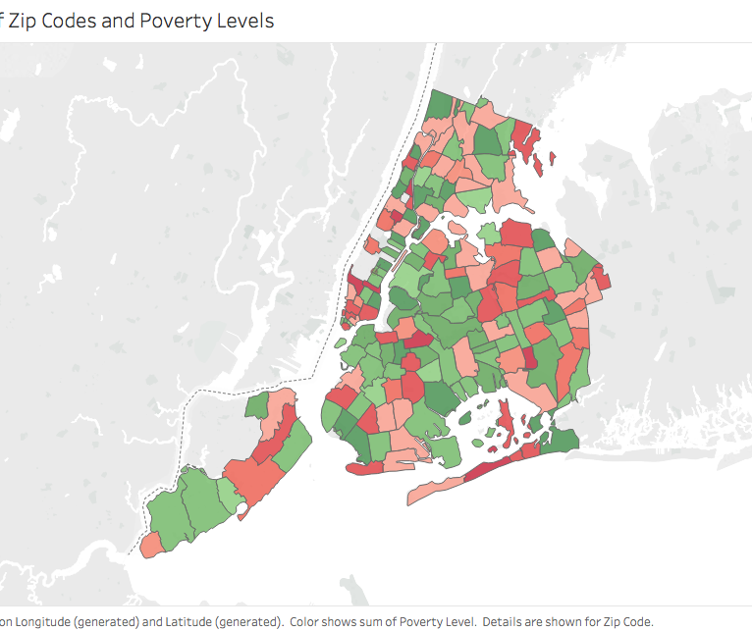
Maps

Slide 8
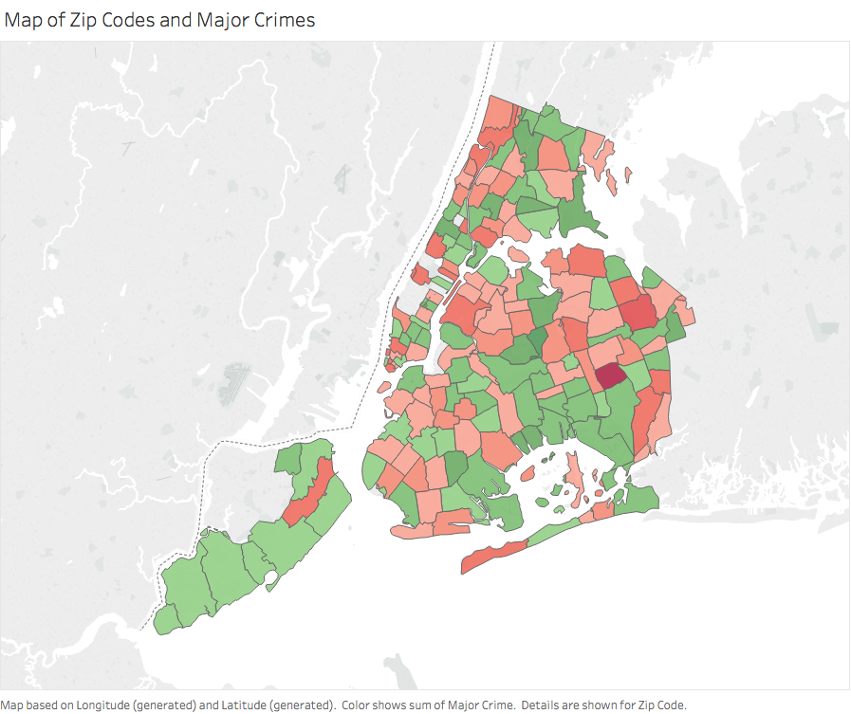
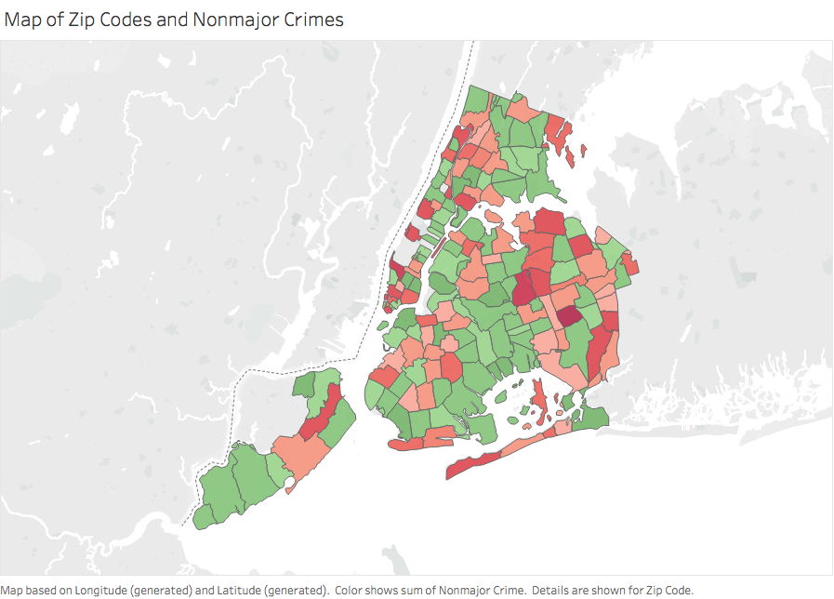
Maps

Slide 9
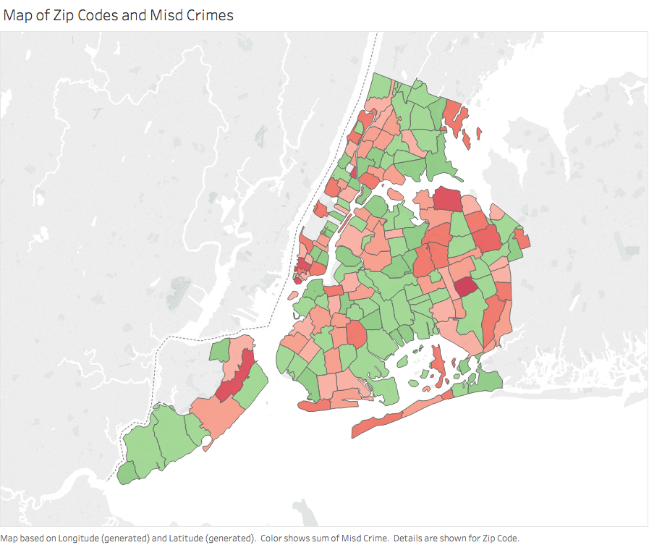
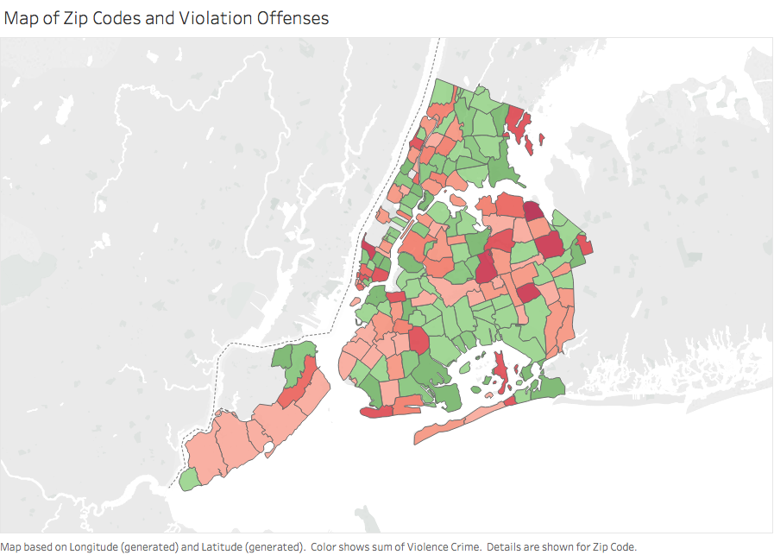
Maps

Slide 10
Pattern Mining Results - Citywide, by Year
Pattern results very similar to overall results, which suggests noise complaints are not a function of year
A few notes: Manhattan makes up the largest proportion of complaints every year (~20% between 2010-2015), followed by Brooklyn, Queens, Bronx, and Staten Island.
Of the residential noise complaints filed, loud music and/or parties make up the majority of the causes (~40%)

Slide 11
Pattern Mining Results - By Borough
Staten Island, Queens, and Manhattan each associated lower population density with noise complaints. Brooklyn and the Bronx each associated higher population density with noise complaints.
Staten Island, Brooklyn, and Queens all otherwise showed similar patterns to the city at large between noise, crime, and poverty, with a few exceptions:
Queens was the only borough to show a relatively strong association between low poverty and higher major felony and violation offense rates, but not other crime rates
Manhattan strongly associated lower crime overall with higher poverty rates

Slide 12
Pattern Mining Results - By Borough
Bronx, on the other hand, had the opposite patterns.
Noise complaints more strongly associated with higher poverty rates and higher crime rates across the board in the Bronx.
This may be because Bronx is poorer and more crime-ridden than the rest of NYC, so noise complaints filed there will invariably come from poorer areas.

Slide 13
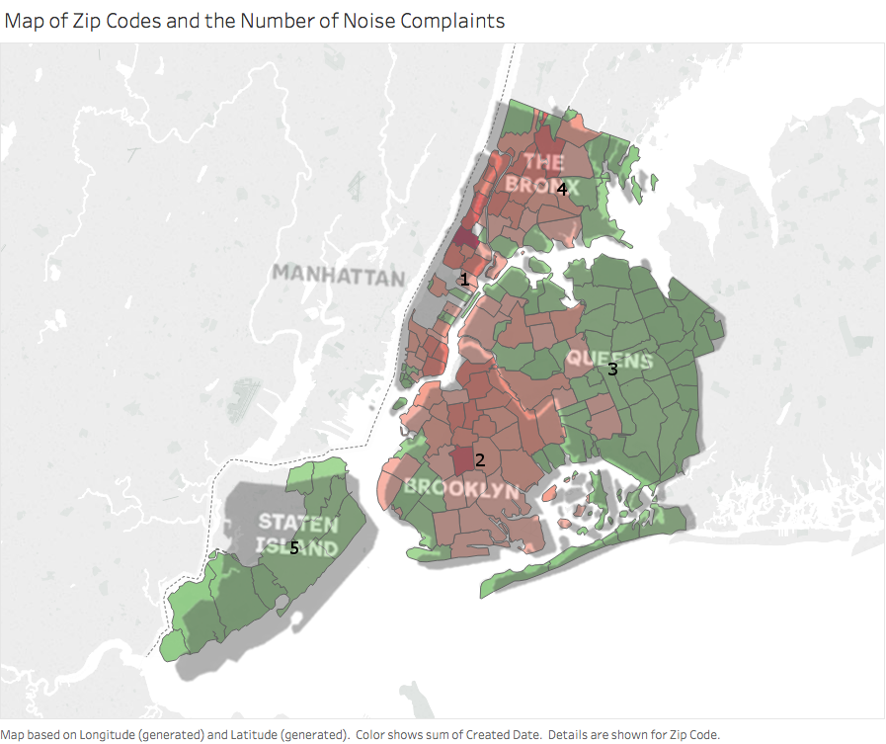
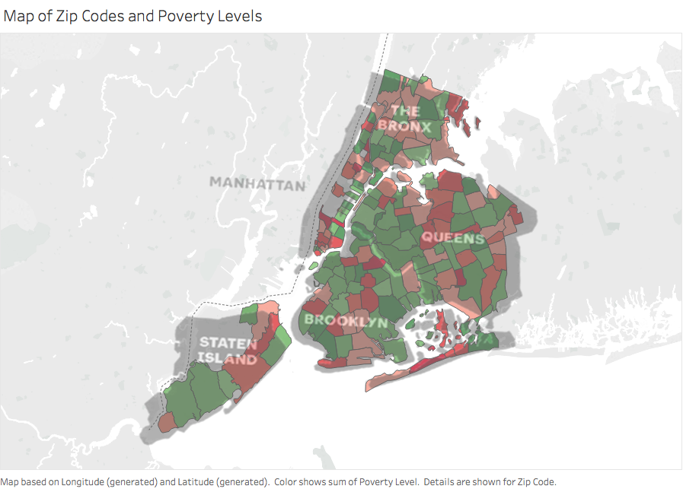
Pattern Mining Results - By Borough

Slide 14
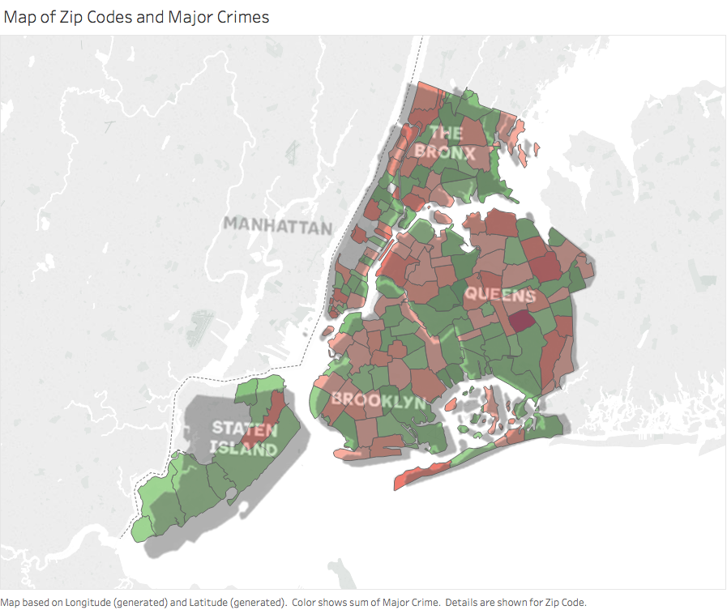
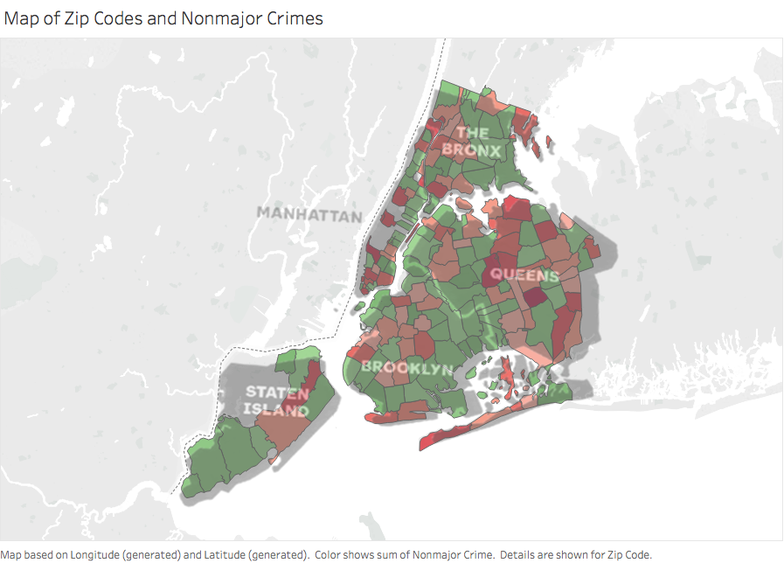
Pattern Mining Results - By Borough

Slide 15
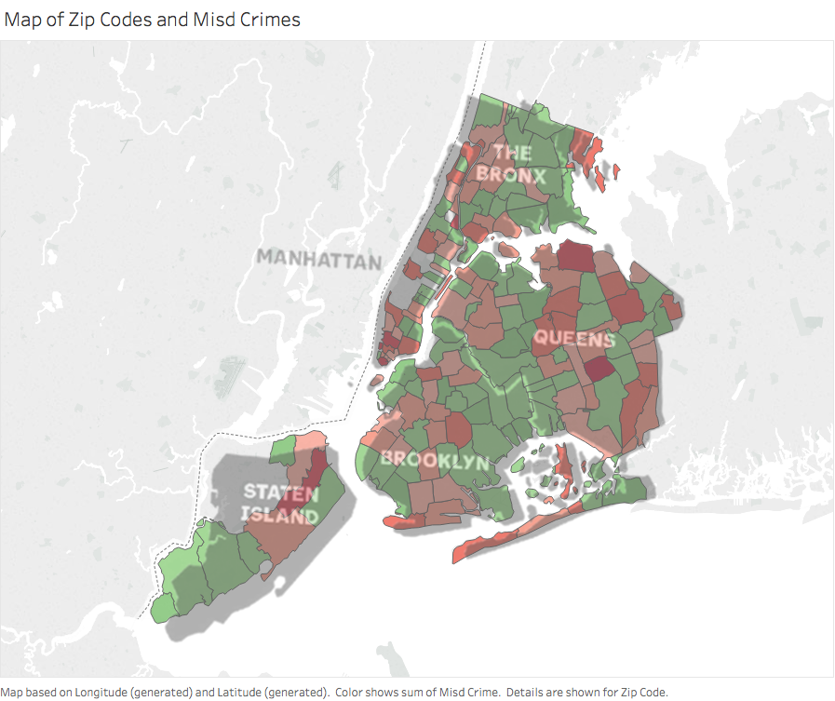
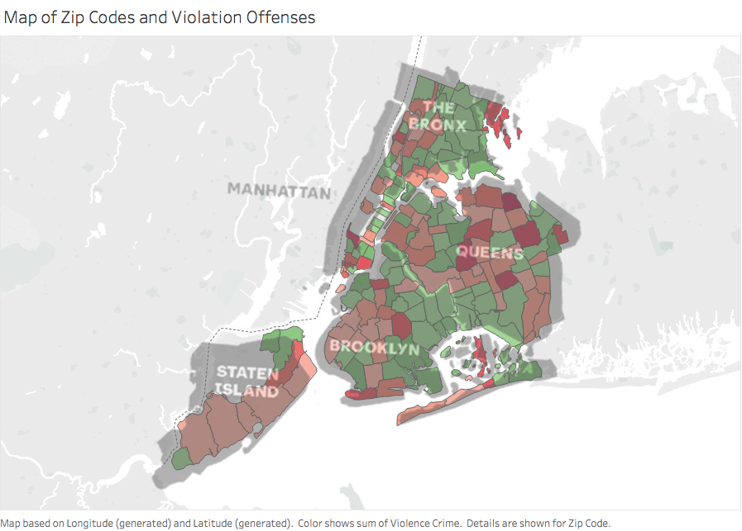
Pattern Mining Results - By Borough

Slide 16
Data Correlation
 | Violation Offenses | Misdemeanors | Major Felonies | Nonmajor Felonies | Poverty Rate
Brooklyn | 0.11 | -0.02 | -0.05 | -0.15 | 0.09
Queens | 0.2 | 0.15 | -0.11 | -0.2 | -0.29
Manhattan | -0.36 | -0.38 | -0.36 | -0.28 | -0.16
Staten Island | 0.25 | 0.68 | 0.39 | 0.69 | 0.44
Bronx | -0.89 | -0.91 | -0.19 | 0.45 | 0.2

Slide 17
Data Correlation
As can be observed from the table, all four categories of crime and poverty have very small correlations with noise complaints which are negligible in Brooklyn and Queens.
All correlation coefficients in Manhattan are negative and larger in terms of values, which indicates some positive but limited linearity.
For Staten Island, notice that noise complaints have relatively high positive correlations with misdemeanors and non-major Crimes while the other correlations are higher than Manhattan’s in absolute value.
For Bronx, noise complaints have very high negative correlations with violation offenses & misdemeanors (-0.89 and -0.91). This means more noise, less crime.

Slide 18
Preliminary Conclusions
Patterns and correlations show that for the most part, noise complaints are inversely related to crime, at least in New York City. Poverty rates are more dependent on which borough you are in.
This is not a causality analysis, and it is nearly impossible to prove any causation from mining the data.
However, the data suggests that when you have neighbors that are all-too-happy to complain about your parties, you’re more likely than not in a safe area. Whether of not that area is poor or not depends on where you are.

Slide 19
Limitations and Further Work
Not every ZIP code has a nearby precinct, so crime statistics may not be totally accurate for every ZIP code
Pattern Mining does not show us what attributes the areas with fewer noise complaints have; a different pattern mining approach would be needed for this
Data may be distorted by the different volumes of noise complaints between boroughs. A modification to FP-Growth to more equally weight the boroughs may help this

Slide 20
Sources
NYC OpenData: 311 Service Requests Database: https://data.cityofnewyork.us/Social-Services/311-Service-Requests-from-2010-to-Present/erm2-nwe9
NYPD Historical Crime Statistics Database: http://www.nyc.gov/html/nypd/html/analysis_and_planning/historical_nyc_crime_data.shtml
ZIPAtlas: Percentage of Population below Poverty Line in New York State by ZIP Code: http://zipatlas.com/us/ny/zip-code-comparison/population-below-poverty-level.htm
PyFPGrowth: https://github.com/evandempsey/fp-growth
Python Packages: PANDAS, NUMPY, Tableau

